Slide 1
Rising Senior Night Class of 2025
Are you ready for your senior year??

Slide 2
Summary of Tonight’s Presentation
Georgia Student Finance Representative will be discussing:
Resources assist you during the senior year and beyond
How to send a transcript and sign up for ACT/SAT
GAFutures.org, HOPE GPA, and HOPE Scholarship
Georgia Match Information
Senior Letter and Senior Packet information: Required Signatures and returning documents
Help from the GSFC Representative Ben Meadows: HOPE Scholarship, HOPE Grant, and FAFSA- Free Application for Federal Student Aid

Slide 3
HELP…I have a Senior in High School
Where do I go when I have questions?
Great Senior Resources…
Senior Canvas Page: paulding.instructure.com/courses/209339
South Paulding High School Homepage: South Paulding High / Homepage
South Paulding High School Counseling Webpage (Counseling Tab on SPHS webpage) or direct link: counselingsphs.weebly.com
Georgia Futures: GaFutures.org
PCSD Counseling Website: https://www.paulding.k12.ga.us/counseling

Slide 4
Course Requests
All students must select a full amount of electives for next year- if accepted into WBL, min day or DE your schedule will be adjusted accordingly. DE and WBL will automatically take precedence over your electives.
But…everyone must have a full amount of electives in case something changes, and you decide not to do DE, WBL or min day.

Slide 5
Work-based Learning
- If you are planning on taking WBL, you need to get your application in ASAP. Space is limited, so don’t wait until August to request this.
- Use the QR code to complete the WBL application.
- Once we get your WBL acceptance, we will replace it with some of the electives you selected.

Slide 6
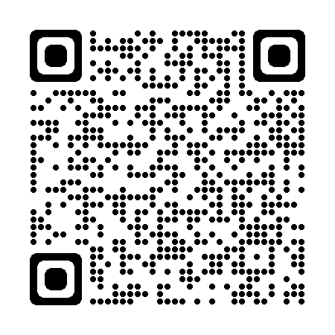
Dual Enrollment
If you are wanting to take dual enrollment classes, you will need to apply to the college of your choice. Make sure that you meet their requirements (GPA, test scores, etc).
- The college must accept you before we can do anything.
- Once you have applied, sent your transcripts and completed the steps on gafutures.org you will need to set up a meeting with your counselor.

Slide 7
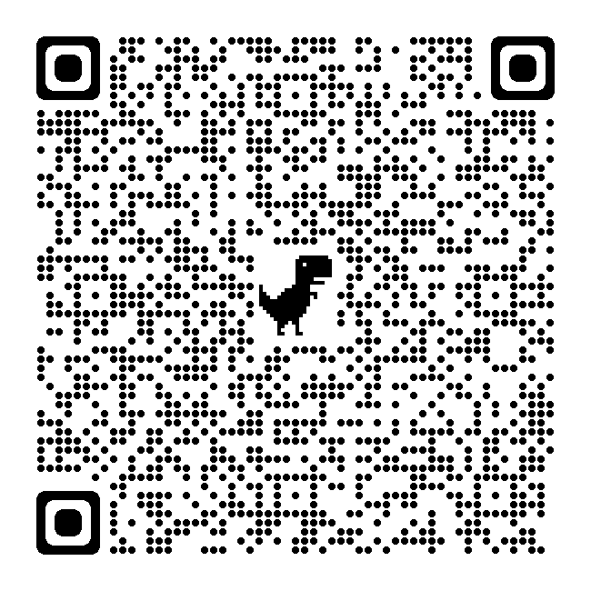
PCCA OPTIONS
PCCA has 4 pathways that you take:
Nursing
Cybersecurity
Energy (Linemen training)
Mechatronics
Complete the QR code to receive more info.

Slide 8
Minimum Day Form
- If you are requesting to have minimum day, you will need to complete the yellow form (with your parent’s signature) and turn that into your counselor.
- You can find the yellow form in the college & career center. They are on the bookshelf on the left as soon as you walk into the C&C center.

Slide 9
How to Sign up for the ACT or Sat?
Students sign up for the ACT or SAT online:
ACT: www.act.org
SAT: www.collegeboard.org
Sign Up now if student has not taken a test yet. It is advised that juniors should take a SAT/ACT in the Spring.
Students must request official test scores from their ACT or SAT accounts when applying to colleges
Make sure to check for schedule conflicts when signing up for a test date
Check deadlines for college applications.

Slide 10
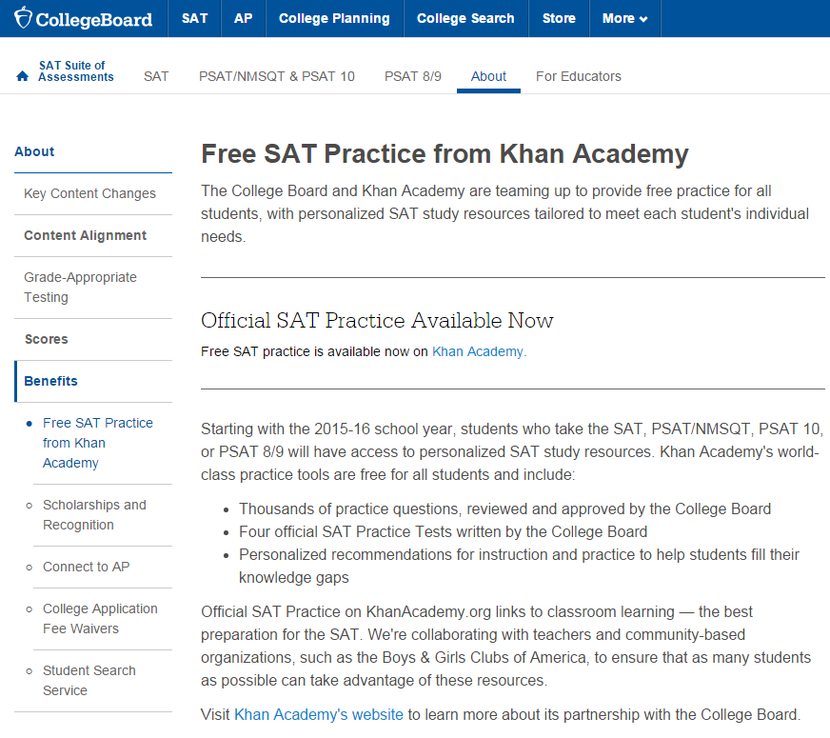
FREE SAT Practice from Khan Academy
https://collegereadiness.collegeboard.org/about/benefits/khan-academypractice
Students that participate and qualify for the free & reduced lunch plan, can use 2 FREE fee waivers for both the SAT and the ACT. See your counselor for those waivers.

Slide 11
Not everyone will make the decision to go to college or technical college next year…..
You and your student can find valuable information on the career exploration section of the GAfutures website
https://www.gafutures.org/career-exploration/
YouScience.com or access through Infinite Campus
On these sites you will learn about:
Yourself
Exploring Careers
Georgia’s Career Clusters and Pathways
Skilled Trades-Go Build Georgia
Military

Slide 12
www.gafutures.org
Why Is Gafutures important to my student?
Gafutures helps students:
Explore options after high school including in-state colleges, universities, and technical colleges
Understand the HOPE scholarship, HOPE grant, HOPE qualifications, state loans,
scholarship search, and more
Review the HOPE GPA and rigor requirements
Request that an electronic transcript be sent to a in-state technical college, college or university
Process college, university, and technical college applications for in-state schools
https://www.gafutures.org/media/113398/final-qg-quick-guide-user-apply-to-college.pdf
NOTE: GAfutures account must have a good, working email.
**It’s important that students use their personal email for this website.
Graduates will have access to this site to send transcripts whenever they need them.

Slide 13
HOPE Scholarship
The HOPE scholarship is determined by GSFC, by the calculation of all academic core courses that a student has taken and completed (grades 9-12). (This is NOT your student’s overall GPA and what you see on their SPHS Transcript)
The only place you can find the HOPE GPA is on the gafutures.org website.
The HOPE scholarship is determined by GSFC by the calculation of all academic courses that a student has taken and completed (grades 9-12).
GSFC stands for Georgia Student Finance Commission.
Courses taken during middle school do not count.
Both passing and failing grades in the core courses count.

Slide 14
Hope Scholarship Continued…
Students must have 4 “rigorous” academic courses to qualify for the HOPE Scholarship.
Double-check that you will have met the rigor course requirement by the end of the year.
Georgia Student Finance Commission Rigorous Course Chart is located on GAfutures.

Slide 15
Common Problems with HOPE GPA
If a student does not have these three key fields correct in our Student Information System as well as in their GAfutures.org Profile, there will be NO HOPE Scholarship:
Legal name that is on birth certificate
Social Security Number
Birth Date
All of the items must match on:
Infinite Campus
GAfutures.org
FAFSA
College Admissions Documents
SAT/ACT
**Remember HOPE GPA = 3.0
*The website www.gafutures.org is a protected site. Counselors do not have access to the student’s password, so they are advised to save their username & password.

Slide 16
How to Request your Transcript
In-State Colleges Transcript Requests are all sent via www.gafutures.org under the “College Planning Tab”:
Technical, Public, and Private colleges.
Out-of-State Colleges:
Request via PCSD Website through Scriborder. See steps in Senior Packet pauldingga.scriborder.com

Slide 17
If your student is going to be a College Athlete…
Students should have an account on the NCAA Clearinghouse if interested in playing Division I or II sports.
Students that are planning on playing NAIA should have an account on the NAIA Clearinghouse.

Slide 18
Financial Aid Opportunities & Scholarships
FAFSA (Free Application for Federal Student Aid) must be completed, even for HOPE Scholarship
Website: Studentaid.gov
TONS of free scholarship sites. Some of my favorites:
www.goingmerry.com
www.scholarships360.org
www.scholarships.com
www.fastweb.com
www.bigfuture.org
www.Gafutures.org
How will I get where I want to go?

Slide 19
Part of the work has been done for your senior. Georgia Match will show your student what colleges they meet the admissions requirements for applying.

Slide 20
Senior Letter
Counselors will be having a one-on-one meeting with your senior to go over what courses must be completed to satisfy graduation requirements.
This is the guide to meeting graduation requirements!
Pathway completions will be discussed as well if there is any need for credit recovery courses.

Slide 21
Senior Pictures
We are using Cady Studios, and the senior roadshows (at the school) will be on July 23 -24 and August 30. Students can begin to sign up for times on May 1 on the Cady Studios website - https://home.cady.com/seniors/
Short video https://drive.google.com/file/d/1YmvYBTdJzUcuiekEM8LfhGezsiJbSmkZ/view

Slide 22
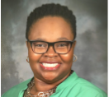
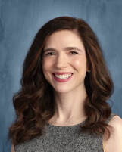
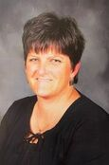
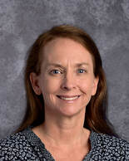
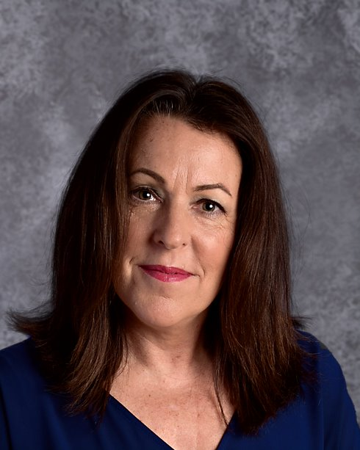
SPHS Senior Night
Counseling Team
​Mrs. Ayanna Clarke-Daniel
aclarkedaniel@paulding.k12.ga.us
Students: A – Bal, T-Z
​Mrs. Christie Hightower
chightower@paulding.k12.ga.us
Students: Ban - D
​Ms. Kirstie Mosier
kmosier@paulding.k12.ga.us
Students: E-H
Mrs. Shannon Allister
​sallister@paulding.k12.ga.us
Students: I - N
Mrs. Michelyn Russell
mrussell@paulding.k12.ga.us
Students O-S

