Slide 1
SPHS 9th and 10th Grade Night

Slide 2
Welcome
We will review:
BRIDGE Law
Graduation Requirements
Dual Enrollment
Work Based Learning Opportunities
Information about Honors and AP courses
SAT/ACT/PSAT/ASVAB
Sophmore/Junior Year Options
Pathways-Advanced Academic, CTAE, Fine Arts, World Language
Post Secondary Plans

Slide 3
SPHS Counseling program
Supports all students in three life areas:
Academics
College and Career
Personal/Social Emotional

Slide 4
BRIDGE Bill – High School
The following BRIDGE Bill advisement tasks are required to
be completed during high school on the student’s Infinite Campus accounts:
9th and 10th Grade:
Explore Dual Enrollment options
Complete the YouScience Career Inventory which is an excellent tool in identifying the student’s natural strengths, personality and careers related to these.
YouScience results are accessed through Infinite Campus (SLDS)

Slide 5
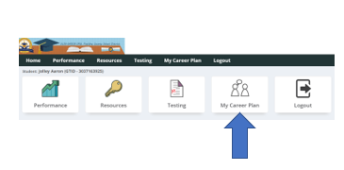
Getting to your students YouScience Results in Infinite Campus

Slide 6
Diploma Requirements Every year we review
4 Units of English
4 Units of Science
4 Units of Mathematics
3 Units of Social Studies
3 Units of Career/Technology and/or World Language and/or Fine Arts
1 Unit of Health & Physical Education/3 Credits of JROTC
4 Units of Electives (minimum)
A total of 23 Units
Note: World Language is not required for Graduation BUT it is
required for acceptance into most 4-year College or University.

Slide 7
Math Requirements (Now have New Names)
9th Grade: Algebra I = Algebra Concepts and Connections
10th Grade: Geometry = Geometry Concepts and Connections
11th Grade: Algebra II = Advanced Algebra Concepts and Connections
12 Grade: Pre-Calculus/AMDM/Stat Reasoning
Or AP Calculus AB or AP Statistics, Dual
Enrollment Math may also be considered
Some students may have taken Honors Algebra I in 8th grade. All students are strongly advised to take Mathematics during the last year of high school, even if the student has met the 4 credits requirement at the close of 11th grade.
Notes:
7

Slide 8
English\Language Arts Requirements
4 TOTAL units of English\Language Arts
The 4 units must include:
* 1 unit of 9th grade Literature and Composition
* 1 unit of American Literature and Composition
*2 additional units in English\Language Arts
**Honors and AP level courses are available
The Honors/AP track is 9th Lit Honors, World Lit. Honors, American Lit Honors or AP Language, & AP Literature (Dual Enrollment off campus)
Some students earned 9th Lit in 9th grade, but all students are strongly advised to take English during the last year of high school, even if the student has met the 4 credits requirement at the close of 11th grade.
Notes:
8

Slide 9
Science Requirements
4 Total Units of Science Required
1 unit of Biology
1 unit of Environmental, Chemistry or Earth Systems
1 unit of Physical Science OR Physics
1 unit of a 4th Science (Anatomy, Forensic Science, Earth Systems, Zoology)
Honors and AP Level Courses are available on campus.
Dual Enrollment Science courses are available off campus.
Notes:
9

Slide 10
Social Studies
3 Units of Social Studies Required
1 Unit of World History (10th Grade)
1 Unit of United States History (11th Grade)
½ unit of American Government (12th Grade)
½ unit of Economics (12th Grade)
Honors and AP Level Courses are available on campus.
Dual Enrollment Social Studies Courses are optional and off campus.
Notes:
10

Slide 11
Career Pathways
Career Pathways are part of a state supported curriculum that encourages and supports students and families in their educational and career planning through long-term goals, knowledge, experience and resources.
Students earn three (3) units of credit in a sequence of CTAE courses in a Pathway. These self-selected Pathways can lead to college readiness and a career readiness certificate.
There is a Career Pathway Assessment given at the end of the three (3) sequential Career Pathway courses
Students may use their required Electives courses to complete more than one Pathway during their high school career.

Slide 12
Elective Courses
Students request their top-4 elective choices for next year.
Students cannot request specific teachers, blocks, or lunches in which to take courses.
Spanish is an academic elective. A World Language is not required for graduation, however most 4-year colleges require a minimum of 2 credits of the same language.

Slide 13
Dual Enrollment and Advanced Placement
With the new law passed by the legislature in February 2020, 11th and 12th grade students may apply to take Dual Enrollment classes. There is limited availability and numerous restrictions for 9th and 10th grade to participate.
Students must meet admissions requirements of the college, university or technical college and be on track to graduate from high school. It is the student’s responsibility to complete the application process in a timely matter (including the GaFutures Funding requirement).
It is recommended that parents and students research this process to make sure DE is the best path. DE students become students of the college and the high school has no access to grades, assignments or absences.

Slide 14
DUAL ENROLLMENT OR AP??
Should your student take Dual Enrollment or Advanced Placement classes? The answer is YES!
Advanced Placement class advantage is courses can be taken as early as the 9th grade year. Make no mistake – these are rigorous courses in which your student can possibly earn college credit depending on how they do on the national AP Exam.

Slide 15
Important Tests for 10th grades
10th Graders take the PSAT, (Preliminary SAT). PSAT is an assessment that can be used to determine areas of strengths and weaknesses.
This assessment has many uses:
Can predict readiness for Advanced Placement courses, as well as being used in looking at college readiness & even for applications for Dual Enrollment with some colleges.
Juniors that take the PSAT can be in the running for the National Merit Scholarship. This is a national program for top scoring testers.

Slide 16
College Entrance Exams SAT/ACT
Check each college website for the latest update on their testing requirements
South Paulding High School code: 111-115
ACT/SAT registration is not done at SPHS
-ACT www.act.org
-SAT www.collegeboard.org
Technical Colleges and some traditional colleges accept the Accuplacer
- Accuplacer www.accuplacer.org
Junior year is typically when a student takes the first test

Slide 17
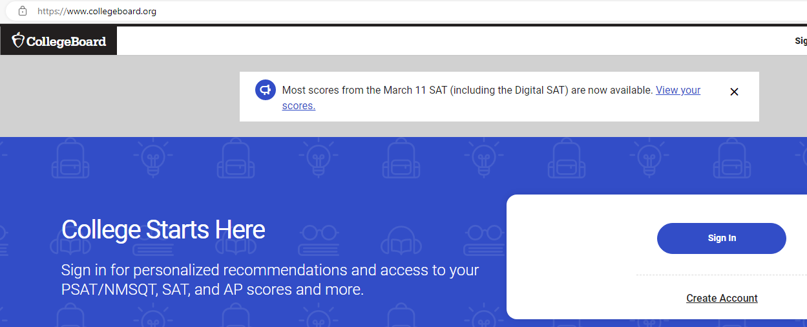
How do I see my PSAT score?
Each student needs to go to collegeboard.org and create an account
Login and your PSAT scores can be seen
You can also connect the test to Khan Academy for personalized test practice.

Slide 18
Fee Waivers for SAT/ACT
To check requirements for a waiver, visit collegeboard.org or ACT.org
Sophomores are not eligible for a waiver
SPHS is given a limited number of waivers. They are issued on a first come first serve basis to students that qualify during their Junior and Senior year

Slide 19
Other Tests You May Need
CHECK THE COLLEGE WEBSITE FOR THE MOST UP TO DATE TESTING REQUIREMENTS
ASVAB (Armed Services Vocational Aptitide Battery)- Aptitude exam required for entrance into the military that determines your eligibility for military jobs. Students may start taking this in their 10th grade year. Remember that the military takes the LAST score when the test was taken, NOT the best score overall.

Slide 20
HOPE Scholarship
HOPE scholarship is determined by the calculation of all academic core and academic elective courses that the student has taken and completed (grades 9-12).
No high school classes taken in middle school are used in the calculation.
Both passing and failing grades in the core courses are part of the overall GPA calculation.
NOW, NOT LATER, IS THE TIME TO FOCUS ON ACADEMIC GPA! IT’S HARD TO BRING UP A GPA…EASY TO BRING IT DOWN.

Slide 21
GAFutures.org
To check your current HOPE Scholarship progress, create an account on GAFutures.org
Spend time on the site learning about how you qualify for the HOPE Scholarship, HOPE Grant and other ways to pay for college.
The site covers how to search for careers, colleges request transcript, and much more!

Slide 22
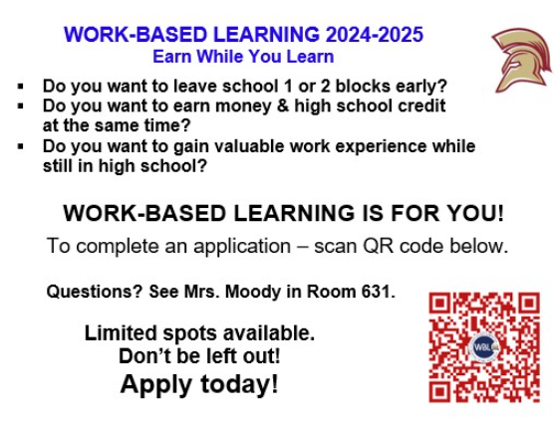
Work Base Learning (11th and 12th Grade Only)

Slide 23
Junior/Senior Year Regular Decision or Early Action College Applications
Considering early actions for college applications?
Common App opens on August 1st (Commonapp.org) typically closes in October for early action at some colleges
Early Action: Junior year would be the last grades on transcript, ACT/SAT testing complete
Early Action: Junior year would be the last year for community service, finding your passion for helping others, participating in extracurricular activities, or summer enrichment programs
Early Action: Competing for college scholarships at the college, need to apply in the fall

Slide 24
College Summer Enrichment
Consider summer programs at a colleges you are interested in possibly applying for
Great way to experience the campus and explore college majors
Colleges with amazing summer programs: UGA, Georgia Tech, Auburn, University of Alabama, Naval Academy ect.
Summer programs range from STEM to Fine Arts
If you want to be an engineer? Examples: Georgia Tech, Auburn, and Boy Scouts of America (STEM Academy)

Slide 25
It’s never too early…
Spend time on the SPHS Counselor’s website:
Counselingsphs.weebly.com

Slide 26
Thank you for coming out!
Please do not hesitate to reach out to your student’s counselor.
A-Bal, T-Z Mrs. Ayanna Clarke-Daniel
Ban-D Mrs. Christie Hightower
E-H Ms. Kirstie Mosier
I-N Mrs. Shannon Allister
O-S Mrs. Michelyn Russell

