Slide 1

Graduation & Beyond
Parent Presentation for the
Class of 2028
Notes:
1

Slide 2

The BRIDGE Graduation Plan
Goals for this evening:
Provide an overview of graduation requirements
Review the IGP/Individual Graduation Plan for each student
Notify SPHS Counseling team of any changes needed.

Slide 3
Promotion Requirements
Students are promoted to the next grade level based on the Cohort Year.
  Cohort Year 1 = Grade 9
  Cohort Year 2 = Grade 10
  Cohort Year 3 = Grade 11
  Cohort Year 4 = Grade 12
Then, students must have a minimum of credits earned.
  From 9th to 10th grade-5 credits
  From 10th to 11th grade-11 credits,
  From 11th to 12th grade-17 credits

Slide 4
Graduation Requirements
4 Units of English
4 Units of Science
4 Units of Mathematics
3 Units of Social Studies
3 Units of Career/Technology and/or World Language and/or Fine Arts
1 Unit of Health & Physical Education
4 Units of Electives (minimum)
A total of 23 Units
Note: World Language (Foreign Language) is not required for Graduation BUT is required for acceptance into a 4 year College or University
Notes:
4

Slide 5
BLOCK SCHEDULE
FOUR 90-MINUTE BLOCKS OF TIME
SEMESTER 1 SEMESTER 2
1
English
2
Science
3
CTAE, Fine Arts, World Language Pathway Course(s)
Health/Personal Fitness (9)
4
Elective (Academic and/or true Elective)
Another course from CTAE, Fine Arts or World Language
1
Math
2
Social Studies
3
CTAE, Fine Arts, World Language Pathway Course(s)
Health/Personal Fitness (9)
4
Another course from CTAE, Fine Arts or World Language
Elective (Academic and/or true Elective)

Slide 6
English\Language Arts Requirements
4 TOTAL units of English\Language Arts
The standard progression in English is as follows…
9th Grade Lit/Comp
World Literature,
American Lit/Comp
British Lit/Comp or Advanced Composition
The Honors/AP track is 9th Lit Honors, World Lit. Honors, American Lit Honors or AP Language, & AP Literature or Dual Enrollment Move on When Ready Courses
The 4 units must include:
* 1 unit of 9th grade Literature and Composition
* 1 unit of American Literature and Composition
*2 additional units in English\Language Arts
Honors and AP level courses are available
Some middle school students may have taken advantage a 9th Grade Lit/Comp
Honors Literature and Composition course this year in 8th grade. All students are strongly advised to take English during the last year of high school, even if the student has met the 4 credits requirement at the close of 11th grade.
Notes:
6

Slide 7
Math Requirements
9th Grade: Algebra: Concepts and Connections Block or Yearlong
10th Grade: Geometry: Concepts and Connections
11th Grade: Advanced Algebra: Concepts and Connections
12 Grade: Pre-Calculus/AMDM/Stat Reasoning
    or
AP Calculus AB or AP Statistics
Dual Enrollment Math may also be considered
Some 8th grade students may have taken Honors Algebra: Concepts and Connections in 8th grade this year. All students are strongly advised to take Mathematics during the last year of high school, even if the student has met the 4 credits requirement at the close of 11th grade.
Notes:
7

Slide 8

Science Requirements
4 Total Units of Science Required
1 unit of Biology
1 unit of Chemistry, Environmental Science, OR Earth Systems
1 unit of Physical Science OR Physics
1 unit of a 4th Science (Anatomy, Forensic Science, Earth Systems, Zoology)
Honors and AP Level Courses are available.
Dual Enrollment Science courses are available.
Notes:
8

Slide 9

Social Studies
3 Units of Social Studies Required
  1 Unit of World History (10th Grade)
  1 Unit of United States History (11th Grade)
  ½ unit of American Government (12th Grade)
  ½ unit of Economics (12th Grade)
Honors and AP Level Courses are available.
Dual Enrollment Social Studies Courses are available.
Notes:
9

Slide 10
Health and Personal Fitness
Health & Personal Fitness Courses
Students will participate in the Alcohol and Drug Awareness Program as part of their health course. Students who successfully complete the test given at the end of this program will receive an ADAP card. Teenagers wishing to receive a driver’s license must have an ADAP card.
Personal Fitness and Health are required courses.
Please note: Some students opt to take 3 credits of JROTC to fulfill this graduation and ADAP requirement.
Notes:
10

Slide 11
World Language Courses
Taking a World Language course is NOT required for graduation, but students who wish to gain admission to a college/university must complete two (2) units of the same World (foreign) Language.
If your student completed the Spanish program in middle school (7th and 8th grades; not 6th), they should make a course request for Spanish II for 9th grade.

Slide 12

Honors and Advanced Placement
Course Information for the CORE Academic and Fine Arts Areas

Slide 13


Why should students take Advanced Placement or Honors classes?
The U.S. Department of Education released a study that shows that by the time students enter college, the type of courses they took in high school is more important than test scores, class rank, or grade averages.
The president of UGA says that rigor of curriculum is a factor above all others that determines success in the college admissions process.

Slide 14

What 9th grade Honors/Advanced Placement classes are available?
Honors 9th Grade Literature/Composition Or 10th Grade Honors World Literature
Honors Algebra: Concepts and Conn
Or Honors Geometry: Concepts and Conn
Honors Biology
Honors World Geography/ AP Human Geography

Slide 15

What do I need to do to get into Honors/AP classes?
Student’s current 8th grade teachers will recommend core classes for 9th grade. These recommendations are based upon the following chart.

Slide 16
Course | Grade Criteria | Teacher Recommendation | Pre-requisite
Honors 9th Literature | Average Grade in subject of 80 or higher | Considering attendance, homework completion, participation, and student work habits | None
Honors World Literature | Average Grade in subject of 80 or higher | Considering attendance, homework completion, participation, and student work habits | Rising 9th grade students must have completed Honors 9th Literature in 8th grade No prerequisite for current 9th graders
Honors Algebra C & C | Average Grade in subject of 80 or higher | Considering attendance, homework completion, participation, and student work habits | None
Honors Geometry: C & C | Average Grade in subject of 80 or higher | Considering attendance, homework completion, participation, and student work habits | Completion of Honors Algebra C & C in 8th grade
Honors Biology | Average Grade in subject of 80 or higher | Considering attendance, homework completion, participation, and student work habits | None
Honors World Geography | Average Grade in subject of 80 or higher | Considering attendance, homework completion, participation, and student work habits | None
AP Human Geography | Average Grade in subject of 80 or higher | Considering attendance, homework completion, participation, and student work habits | None
Honors Spanish II | Average Grade in subject of 80 or higher | Considering attendance, homework completion, participation, and student work habits | Rising 9th grade students must have completed Spanish I in 8th grade No prerequisite for current 9th graders

Slide 17

How are Honors/AP classes beneficial to my GPA?
Honors courses are weighted. With successful completion of the course, an average of 70 or above BEFORE weights are added, earns a student five (5) points onto the final course average.
For example: Student earns an 80 in Honors 9th Grade Lit/Comp – the report card and transcript will reflect an 85 as the weighted points are added to the final average.
Advanced Placement courses add 10 points to the final grade, if a 70 or above has been earned.

Slide 18
Pathway/Plan of Study
  Pathway: a plan of study that requires 3 sequential courses with an Area of Focus:
  CTAE
  Fine Arts
  World Language

Slide 19
Career, Technical and Agricultural Education
Career, Technical, and Agriculture Education (CTAE) integrates core academic knowledge with technical and occupational skills to prepare students for post-secondary education and the workforce.
CTAE Career Clusters and their Pathways are part of a state supported curriculum that encourages and supports students and families in their educational and career planning through long-term goals, knowledge, experience and resources.
Notes:
19

Slide 20
Fine Arts
Fine Arts- Students can take visual or performing art courses as a pathway of study. Arts education includes the study of dance, media arts, music, theatre/film, and visual arts.
Notes:
20

Slide 21

World Language
Spanish
French

Slide 22

End of Course Assessments (EOCs)
English Language Arts
American Literature and Composition
Mathematics
Algebra: C&C
Science
Biology
Social Studies
United States History
***EOC Assessments count 20% of a student’s final grade.***
Notes:
22

Slide 23
Dual Enrollment
A process by which all 11th & 12th grade (and some 10th) students take courses from a state public or private postsecondary institution while still enrolled as a high school student and receive credit both at the high school and at the postsecondary institution.
Notes:
This is the all encompassing definition of DE that covers all the different type of programs we have that fall under DE.
If students are involved with a program where they are getting credit at both the HS and College levels simultaneously, then it falls under dual enrollment.
Next SLIDE
23

Slide 24


Things to consider about being a Dual Enrollment Student….
Maturity level of the student
Post-secondary plans of the student
Individual career goals and IGP (Individual Graduation Plan)
Necessary tests for admission to the postsecondary institution(s) of choice
Application and acceptance by the post-secondary institution

Slide 25
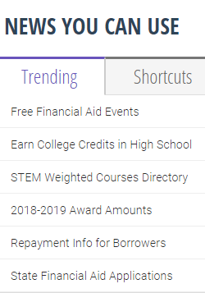

Dual Enrollment Information on GAfutures

Slide 26
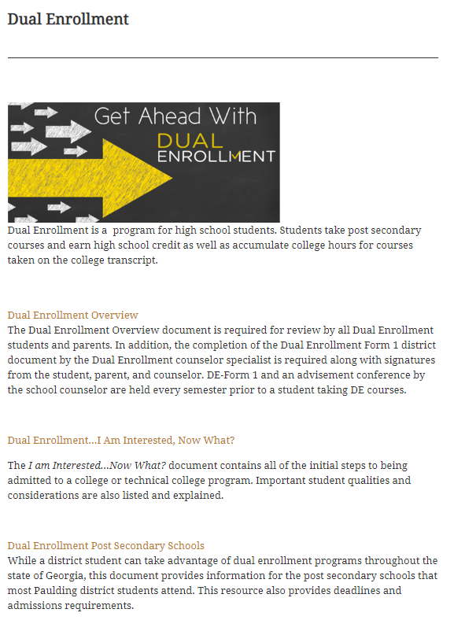
Counseling Website Link with DE Information: https://counseling.paulding.k12.ga.us/index.php/academic/dual-enrollment/

Slide 27

HOPE and Zell Miller Scholarship
Core courses are included in the student’s HOPE high school GPA for HOPE Scholarship and Zell Miller Scholarship eligibility determinations.
HOPE GPA = 3.0
Zell Miller GPA = 3.7 / ACT = 26 / SAT = 1200 (one test administration)
Academic rigor course requirements are listed on gafutures.org. Students must have a minimum of 4 rigor classes.
The HOPE GPA calculation has a cap of 4.0.
Dual Enrollment hours do not count against any HOPE hour cap.
HOPE GPA can only be found on gafutures.org

Slide 28

Virtual Opportunities
PVA registration open until 2/16/24
There is no opt-out period. Applicants are committing to PVA for the entire 2024-2025 school year.

Slide 29

What is Paulding Virtual Academy?
The Paulding Virtual Academy (PVA) will offer students the opportunity to use teacher supported, technology-based courses to earn new high school credit, recover credit, continue coursework or accelerate their progression through high school and into college level courses.
PVA registration opens until 2/16/24
Link for more information: https://www.paulding.k12.ga.us/domain/5924

Slide 30

What is the Paulding College and Career Academy?
PCCA opened in the Fall semester of 2019
Students who attend PCCA graduate with a high school diploma plus have:
  Dual Enrollment Course Opportunities
  Work-Based Learning/Apprenticeship Program Courses
  Complete a CTAE Pathway and related courses

Slide 31

What are the Opportunities at the PCCA?

Slide 32
PCCA Basics
Requirements:
NONE! You simply have to be a high school student in the district and apply for PCCA.
Please talk with your counselor if you are interested as it will impact your schedule.
Applications:
Applications are posted on the district and PCCA website labeled “PCCA Interest Form”.
Transportation:
Students are bussed from their local high school to PCCA and back to the local high school.

Slide 33
TEST-OUT
OPPORTUNITIES
Basic Requirements
1. Limit is 3 courses during high school with a cap of 3 credits earned.
2. PCSD Test-out Registration Opportunity as announced each year. This an Online registration opportunity on the district website.
3. Student cannot have started a course(s) that he/she is planning to test-out.
4. During registration a payment of $50.00 must be made for each test. Students who score Distinguished will have this money reimbursed after scores come back.
5. During February a grade of B or higher will be validated. Also, during February a teacher recommendation regarding the test-out opportunity must be received by the school counselor. This recommendation is completed by the student’s teacher in the subject area.
6. EOCs taken during March.
7. For a student who receives a Distinguished score, the high school transcript is updated with course, grade/score and credit earned.

Slide 34

High School Athletic Eligibility
First semester freshmen may participate in sports and extra-curricular activities.
To Keep Eligibility:
  Each student must earn at least 2.5 credits in the previous semester.
    9th grade students must have earned 2.5 credits in the fall to participate in the spring..
  Each student must stay “on track” to graduate.
    This means that by the start of the sport you are playing you must have earned the following number of credits:
      10th Grade: 5.0 Credits
      11th Grade: 11.0 Credits
      12th Grade: 17.0

Slide 35
Additional Resources for Transitioning to High School

Slide 36
High School 101
&
Career Planner
High School 101
- Located on the PCSD Website
- Gives course descriptions & provides in-depth information about High School.
Career Planner
- Located on the PCSD Website.
- Gives sequencing guides and further information about courses offered in the district.

Slide 37

During 9th – 12th Grade and After High School Graduation
GAFutures (MyGAfutures Account)
  Your MyGAfutures
  GPA HOPE information
  College Applications in Georgia
  Scholarships
  FAFSA and Financial Aid
  Financial Literacy
  Dual Enrollment Application
  to Georgia Student Finance
  Commission

Slide 38
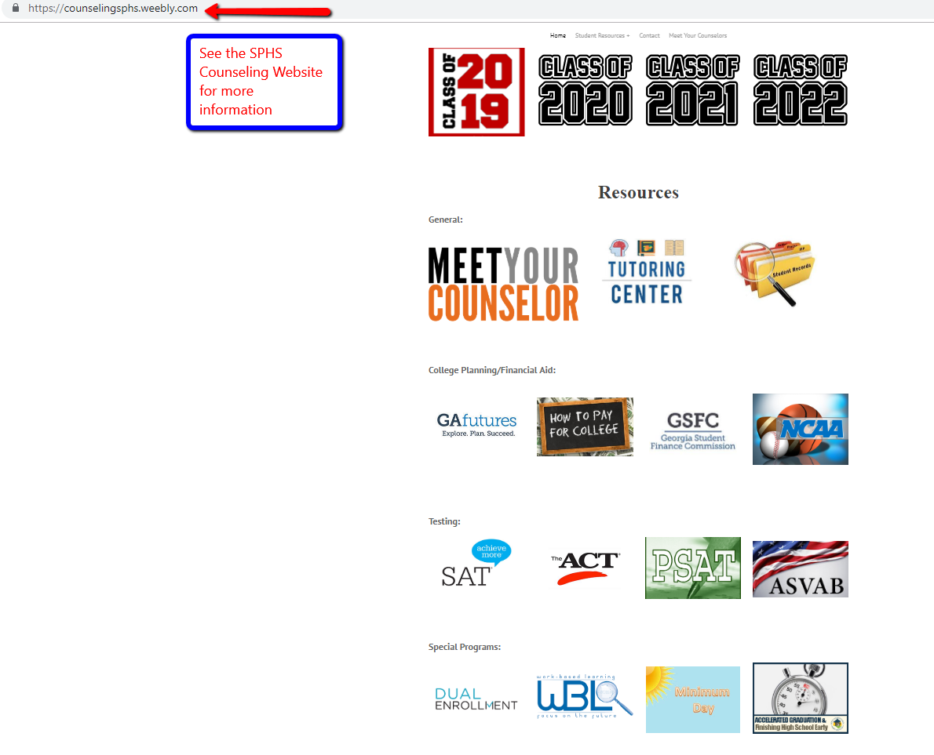
SPHS Counseling Webpage

Slide 39
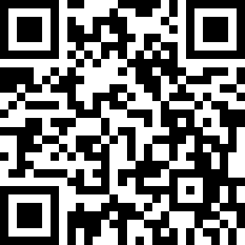
SPHS Counseling Website

Slide 40
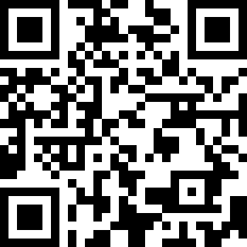
Creating a Parent Portal – Infinite Campus Account

Slide 41
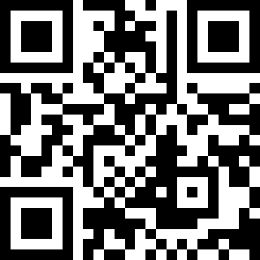
Creating a Parent Observer Canvas Account

Slide 42
Verify your Student’s Class Selection

Slide 43
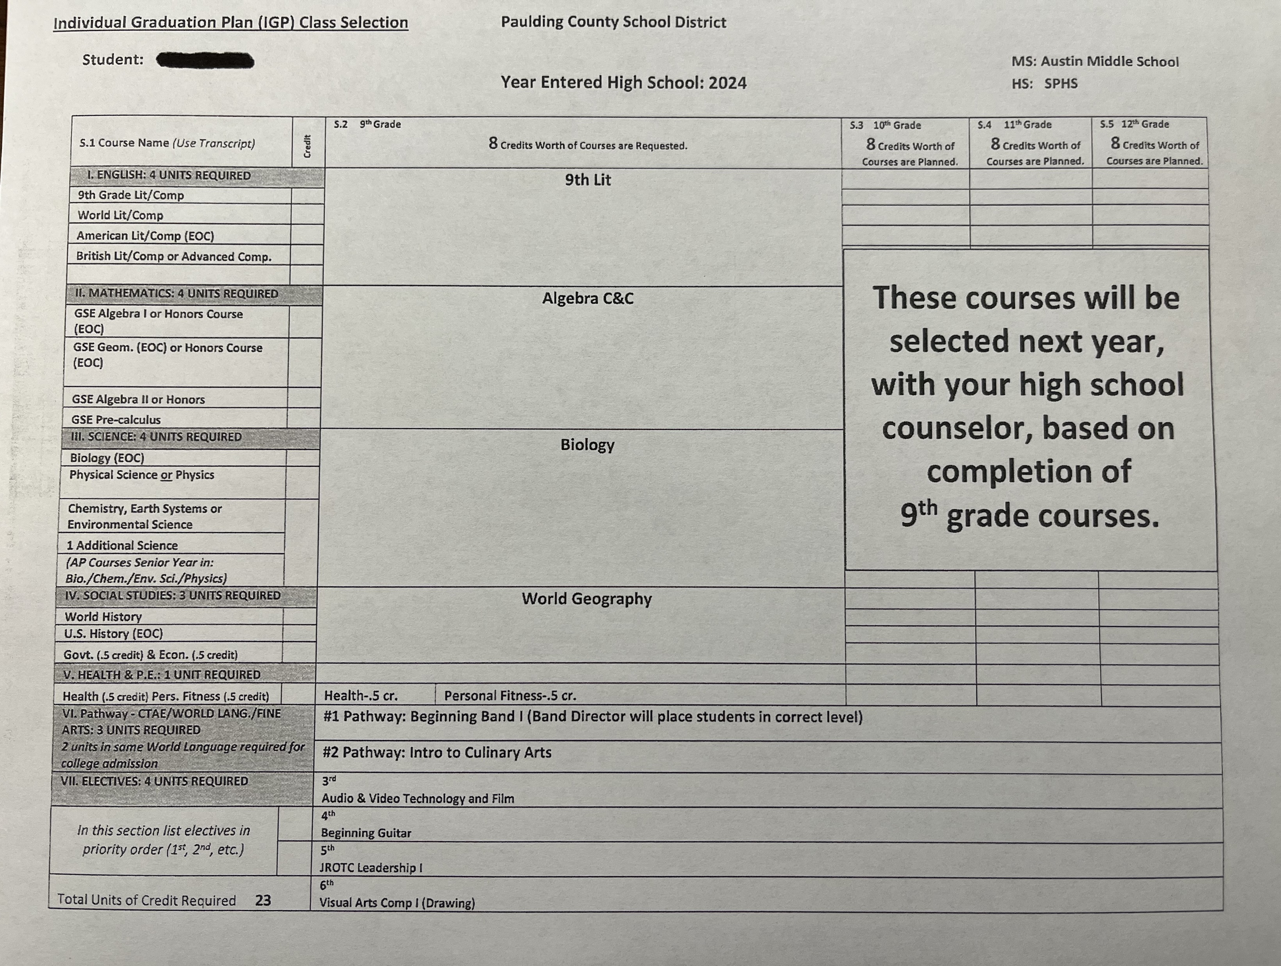
Individual Gradual Plan Class Selection

Slide 44
School counselors support all students in three areas:
Academic
Career
Personal/social
Thank you for your time and involvement!
We appreciate you!

