Slide 1

Class of 2024
Mission Possible:
Graduation and Beyond
Welcome
SPHS Senior Parents and Students

Slide 2
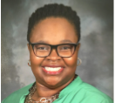

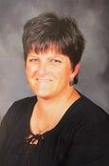
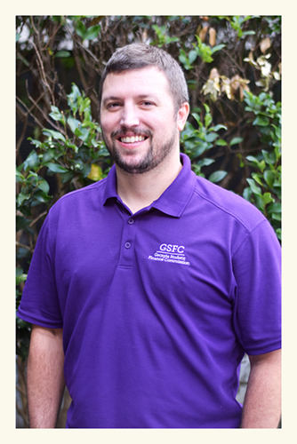
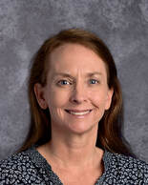
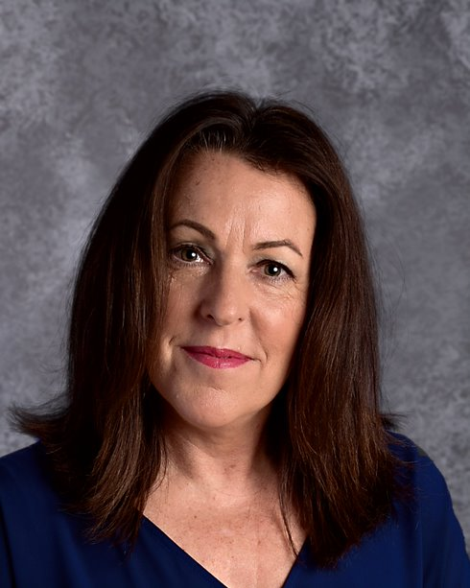
SPHS Senior Night
Speaker Panel
​Mrs. Ayanna Clarke-Daniel
SPHS Counselor
aclarkedaniel@paulding.k12.ga.us
Students: A – Bal, T-Z
​Mrs. Christie Hightower
SPHS Counselor
chightower@paulding.k12.ga.us
Students: Ban - D
​Ms. Kirstie Mosier
SPHS Counselor
kmosier@paulding.k12.ga.us
Students: E-H
Mrs. Shannon Allister
SPHS Counselor
​sallister@paulding.k12.ga.us
Students: I - N
Mrs. Michelyn Russell
SPHS Lead Counselor
mrussell@paulding.k12.ga.us
Students O-S
Mr. Ben Meadows
GSFC Representative
benm@gsfc.org

Slide 3
SummarYof the Evening
The SPHS Counselors and Georgia Student Finance Representative will be discussing:
  Resources assist you during the senior year and beyond
  How to send a transcript and sign up for ACT/SAT
  GAFutures.org, HOPE GPA, and HOPE Scholarship
  Georgia Match Information
  Senior Letter and Senior Packet information: Required Signatures and returning documents
  Help from the GSFC Representative Ben Meadows: HOPE Scholarship, HOPE Grant, and FAFSA- Free Application for Federal Student Aid

Slide 4
HELP…I have a Senior in High School
Where do I go when I have questions?
Great Senior Resources…
Senior Canvas Page: paulding.instructure.com/courses/209339
South Paulding High School Homepage: South Paulding High / Homepage
South Paulding High School Counseling Webpage (Counseling Tab on SPHS webpage) or direct link: counselingsphs.weebly.com
Georgia Futures: GaFutures.org
PCSD Counseling Website: https://www.paulding.k12.ga.us/counseling

Slide 5
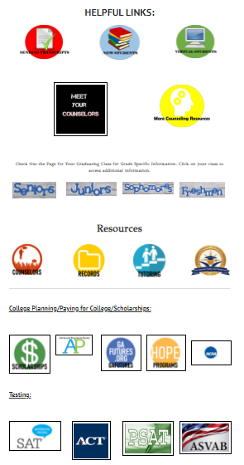
SPHS Counselor Webpage: counselingsphs.weebly.com

Slide 6
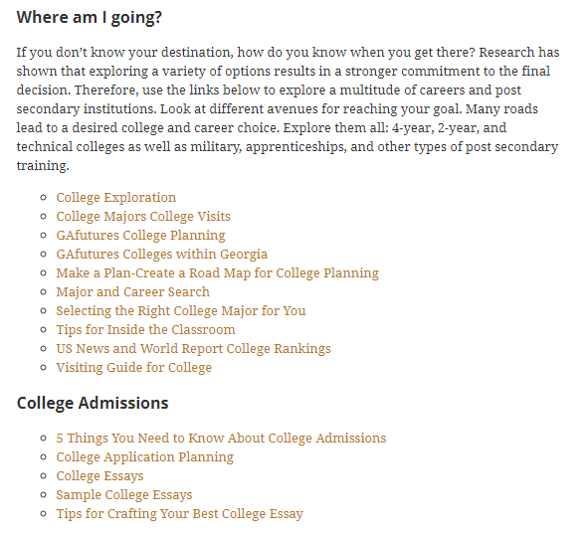
PCSD Counseling Website https://www.paulding.k12.ga.us/counseling

Slide 7
How to Sign up for the ACT or Sat?
Students sign up for the ACT or SAT online:
  ACT: www.act.org
  SAT: www.collegeboard.org
Sign Up now if student needs a better score or needs to take either or both tests
Students must request official test scores from their ACT or SAT accounts when applying to colleges
Make sure to check for schedule conflicts when signing up for a test date
Check deadlines for college applications so student’s scores are available to meet those deadlines

Slide 8
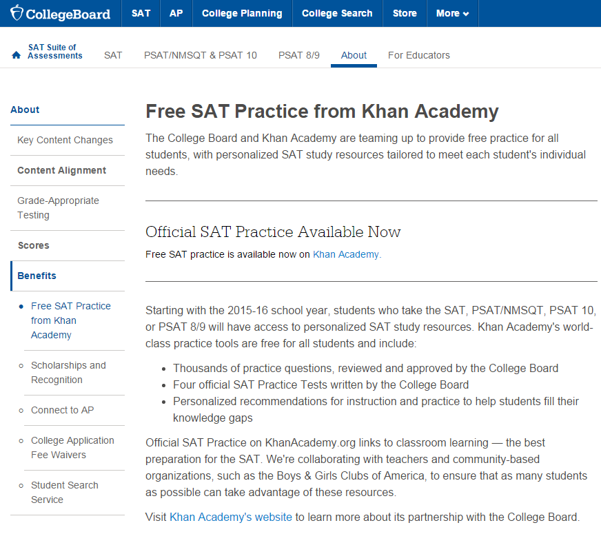
FREE SAT Practice from Khan Academy
https://collegereadiness.collegeboard.org/about/benefits/khan-academypractice

Slide 9
Not everyone will make the decision to go to college or technical college next year…..
You and your student can find valuable information on the career exploration section of the GAfutures website
https://www.gafutures.org/career-exploration/
YouScience.com or access through Infinite Campus
On these sites you will learn about:
  Yourself
  Exploring Careers
  Georgia’s Career Clusters and Pathways
  Skilled Trades-Go Build Georgia
  Military

Slide 10

www.GAfutures.org
Why Is Gafutures important to my student?
  Gafutures helps students:
  Explore options after high school including in-state colleges, universities, and technical colleges
  Understand the HOPE scholarship, HOPE grant, HOPE qualifications, state loans,
  scholarship search, and more
  Review the HOPE GPA and rigor requirements
  Request that an electronic transcript be sent to a in-state technical college, college or university
  Process college, university, and technical college applications for in-state schools
  https://www.gafutures.org/media/113398/final-qg-quick-guide-user-apply-to-college.pdf
  NOTE: GAfutures account must have a good, working email.

Slide 11
HOPE Scholarship
Georgia’s HOPE Scholarship is available to Georgia residents who have demonstrated academic achievement. The scholarship provides money to assist students with the educational costs of attending a HOPE eligible postsecondary institution located in Georgia.
The HOPE scholarship is determined by GSFC, by the calculation of all academic core courses that a student has taken and completed (grades 9-12). (This is NOT your student’s overall GPA and what you see on their SPHS Transcript)
Students must have a HOPE GPA of 3.0
Students must have 4 “rigorous” academic courses to qualify for the HOPE Scholarship.
Georgia Student Finance Commission Rigorous Course Chart is located on GAfutures.
Double-check that you will have met the rigor course requirement by the end of the year.
Courses taken during middle school do not count.
Both passing and failing grades in the core courses count.
Remember to monitor your HOPE GPA via your GAFutures account.
Apply by filling out the Free Application for Federal Student Aid (FAFSA) or the online Georgia Student Finance Application (GSFAPP)

Slide 12
HOPE GPA
If a student does not have these three key fields correct in our Student Information System as well as in their GAfutures.org Profile, there will be NO HOPE Scholarship:
  Legal name that is on birth certificate
  Social Security Number
  Birth Date
All of the about items must match on:
  Infinite Campus
  GAfutures.org
  FAFSA
  College Admissions Documents
  SAT/ACT
**Remember HOPE GPA = 3.0

Slide 13
How to Request your Transcript
In-State Colleges Transcript Requests:
  Request via GAFutures – Technical, Public, and Private colleges. See steps in Senior Packet
  https://www.gafutures.org/
Out-of-State Colleges:
  Request via PCSD Website through Scriborder. See steps in Senior Packet
  pauldingga.scriborder.com
***There needs to be plenty of lead time for transcripts to accompany college and scholarship applications

Slide 14
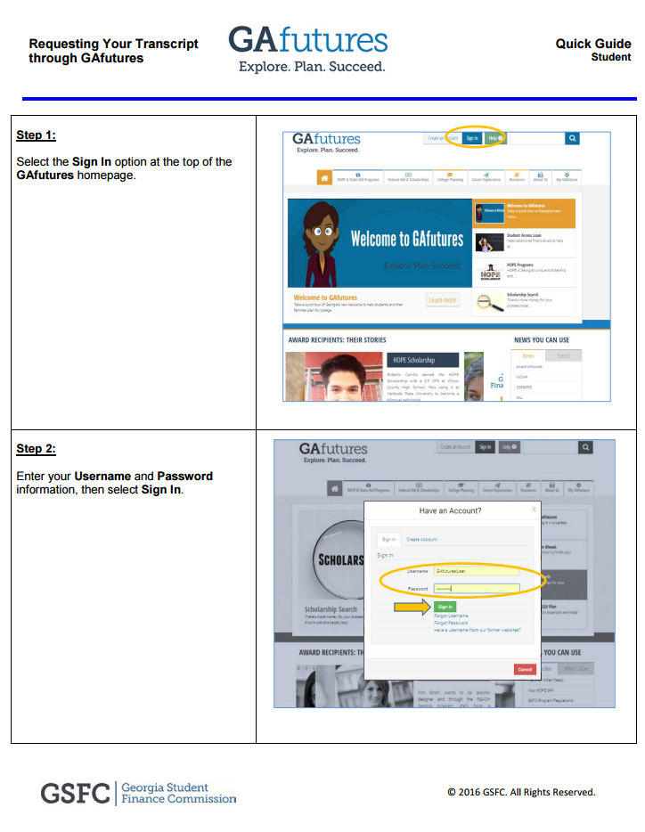
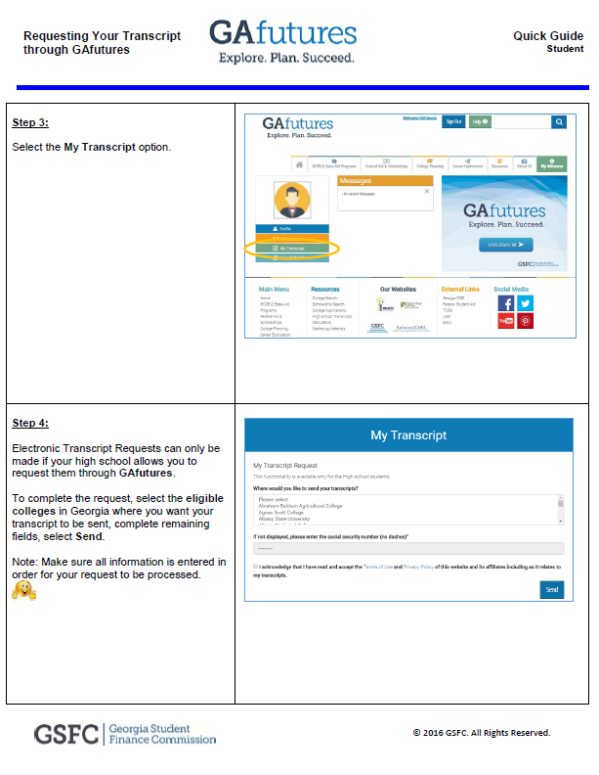
Requesting a Transcript https://www.gafutures.org/media/113401/final-qgquick-guide-user-requesting-transcript-through-gafutures.pdf

Slide 15
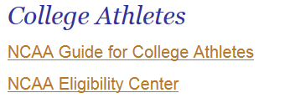
If your student is going to be a College Athlete…

Slide 16

Financial Aid Opportunities &
Scholarships
How will I get where I am going?
FAFSA (Free Application for Federal Student Aid) must be completed, even for HOPE Scholarship
Website: Studentaid.gov

Slide 17

Georgia Match

Slide 18
Senior Letter
This is the guide to meeting graduation requirements!

Slide 19
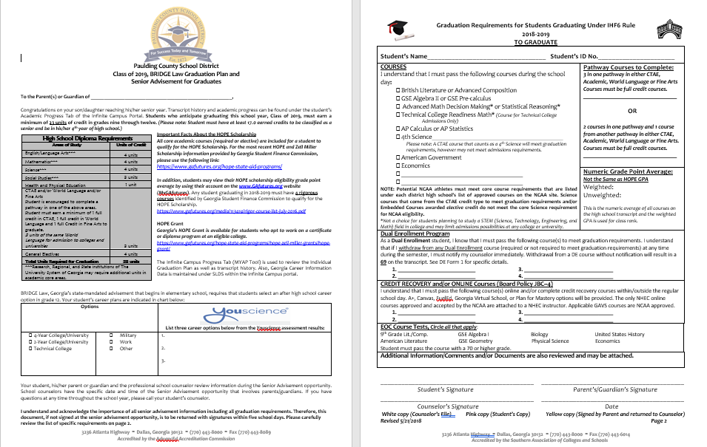
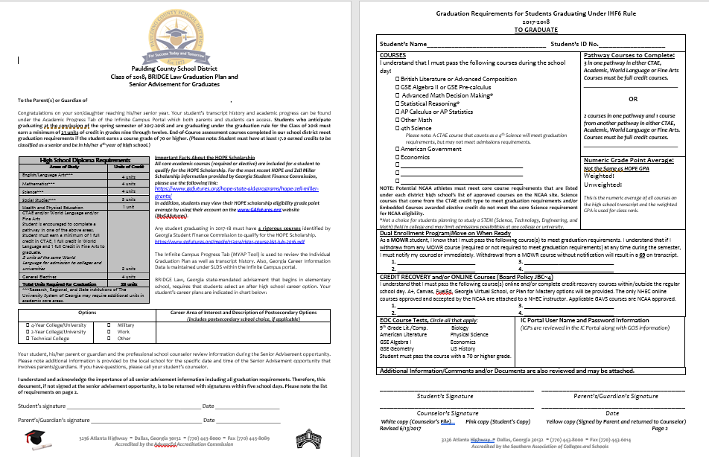
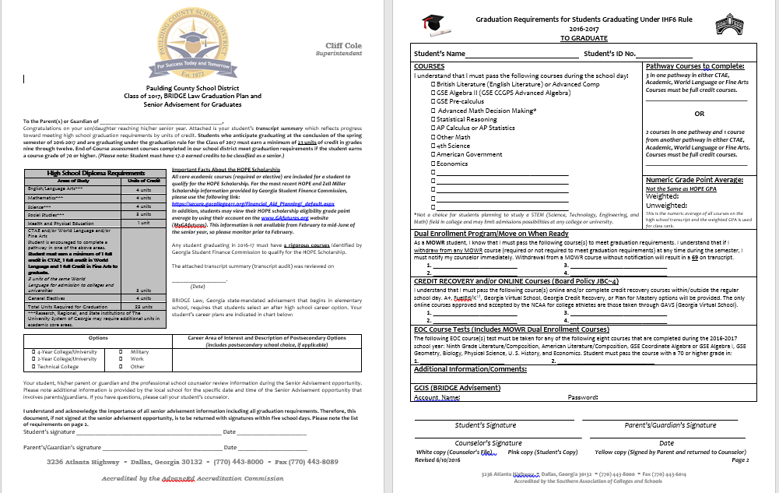
Senior Letter
Page 2
Page 1

Slide 20
Senior Letter – Page 1
Graduation Requirement Chart
  Counselors have audited your senior’s transcript history.
  Please remember counselors are supporting your student to be a Pathway Completer with 3 sequential courses in CTAE or Fine Arts or World Language.
  Counselors consult with students about meeting graduation requirements with three full credits in the areas of CTAE, Fine Arts and/or World Language, if the student is not a pathway completer.
Making Decisions About the Next Step After High School
Student’s have chosen their post secondary option(s) and indicated their career plans.
Very important - 2 credits in the same World Language must be earned to be admitted to some two and all four-year colleges and universities.

Slide 21
Senior Letter-Page 2
Courses are listed that must be completed to graduate.
Pathway completion courses are documented.
Online and Credit Recovery Courses are listed, if applicable.
Any other information specific to your student is also noted on page 2 by the school counselor.

Slide 22
Senior Packet review
Handouts in Senior Packet
Please keep the handouts that cover:
  How to create a Georgia Futures Account
  How to request a student transcript through GA Futures
  How to review your HOPE GPA on GA Futures
  How do I… document
  Student’s Schedule
  Student’s Transcript
Please sign and return:
  Your student’s Senior Letter, pages 1 & 2

Slide 23
Parents and Students Please Complete, Sign, and Turn In The Yellow copies of the Senior Letter
Page 1 of Senior Letter - Student Checks box or boxes to indicate plans beyond high school as well as listing careers. This is the Next Steps Bridge Bill Task for Seniors
Page 2 of Senior Letter – Student & Parent complete with signatures
Return both yellow copies of the senior letter with signatures tonight as you exit

Slide 24

Congratulations Class of 2024

